Slide 1

Winterbourne Babysitter
Hannah Ashna Jacob
(N0865554)

Slide 2
UNESCO ESD Competencies
Research Theme
Climate change and biodiversity in 'winterbourne' chalk streams
Guidelines
Critical Thinking Competency
Anticipatory Competency
Self Awareness Competency
National Learning Network Guidelines
COBLIS (Colour Blindness Simulator Tool)
Education for Sustainable Development Guide
UN Sustainable Development Goals (SDGs)
Climate Action
Life Below Water
Sustainable Consumption

Slide 3
Mechanics
The game will employ the combination of two types of mechanics, resource management and questing.
The quest mechanic will have the player either accept or decline different missions that relate to the gathering of resources.
The resource management mechanic will test the player’s ability to take care of the village’s eggs in the nursery over the drought period.
Each egg has a specific ‘comfort threshold’. Going out of this range can result in deadly consequences for the egg.
The player needs to act accordingly by either warming up or cooling down the eggs when needed using their gathered sources. Yet, with a limited number available to them they might need to strategize and problem-solve on the fly.

Slide 4
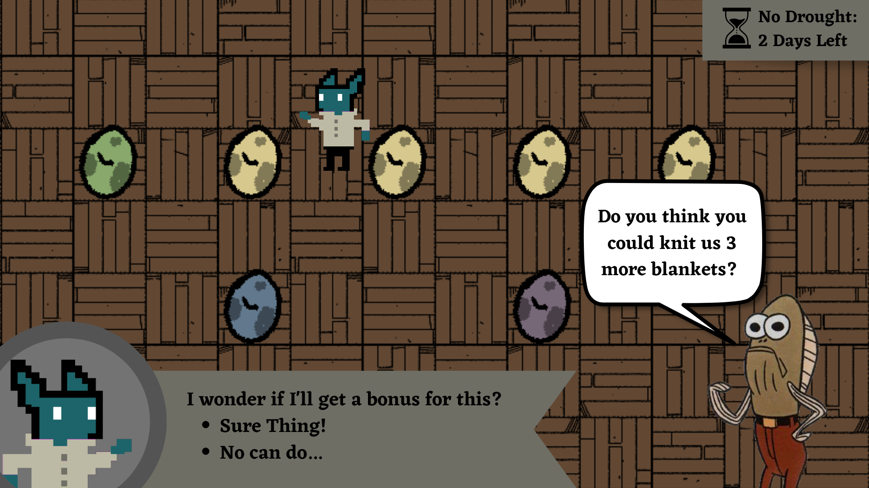

Slide 5
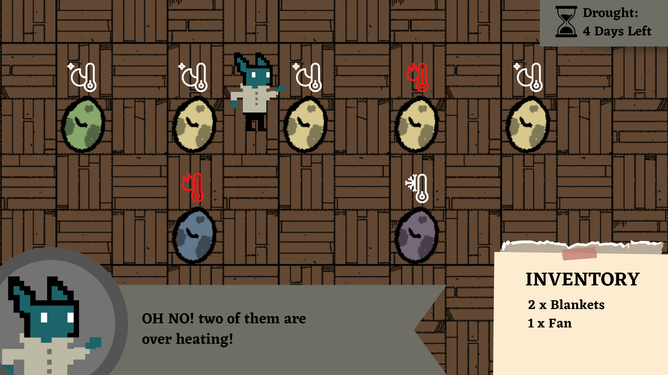

Slide 6
Game Objectives
The game is cyclical in nature, wherein it moves between drought and non-drought seasons. The game is meant to be played within 10 to 15 minutes and through this cyclical design, it gets across its message within the first few rounds as the player begins to battle the influence of climate change on the drought conditions.
The primary objective is to ensure the survival of the community for as long as possible. The challenge however is the ‘dry’ phases will start to become longer, drier, more frequent, and less predictable over time with dangerous heat waves posing a threat to the community.
The game aims to evoke a sense of concern and sadness and ultimately a desire for action in a player as they realise the inevitable result of the worsening drought periods on this community.

Slide 7
Response to Feedback
The game’s target group are university students – more specifically the game is meant to be used to facilitate discussion surrounding the impact of climate change on biodiversity.
As the target group are students, the game will look to focus on more ‘local’ solutions or routes of action. Within the game, this will look like quest opportunities to bring the community together to create more or better resources to protect the eggs.
From outside the game, this will look like recommending different ongoing projects that students can partake in to support – i.e., the ‘Dry Rivers’ app that researchers ask people to download and interact with to help support ongoing efforts in documenting local dry rivers.

